Slide 1
2026 National Ryan White Conference on HIV Care & Treatment August XX, 2026
Connecting the Dots: FHIR, CAREWare, and Better RSR Data
Kwasi Apraku-Gyau, Sr. Management Analyst
HIV/AIDS Bureau (HAB)

Slide 2
Project Support
This project and product was supported by Grant 75R60226Q00057 from the Health Resources and Services Administration (HRSA) of the U.S. Department of Health and Human Services (HHS). Its contents are solely the responsibility of the authors and do not necessarily represent the official views of HRSA.

Slide 3
Disclosure
No participants have disclosures.

Slide 4
HRSA’s HIV/AIDS Bureau Vision and Mission
Vision
Optimal HIV care and treatment for all to end the HIV epidemic in the U.S.
Mission
Provide leadership and resources to advance HIV care and treatment to improve health outcomes and reduce health disparities for people with HIV and affected communities.
Notes:
Script
As always, we like to begin by sharing our HIV/AIDS Bureau mission and vision. (Read mission and vision)
As you may imagine, it’s been an unprecedented year for the HIV/AIDS Bureau, and we appreciate our Ryan White HIV/AIDS Program’s grant recipients and community’s flexibility as we continue to implement an incredibly important and impactful program. We in the HIV/AIDS Bureau focus every day on the fact that because our program exists, people with HIV who otherwise could not access medications or treatment are getting HIV services that help them manage a chronic disease and prevents forward HIV transmissions.

Slide 5
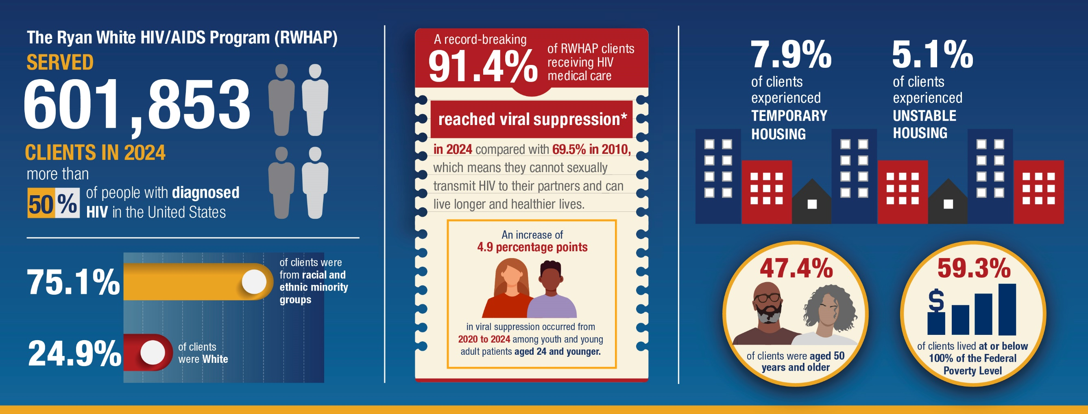
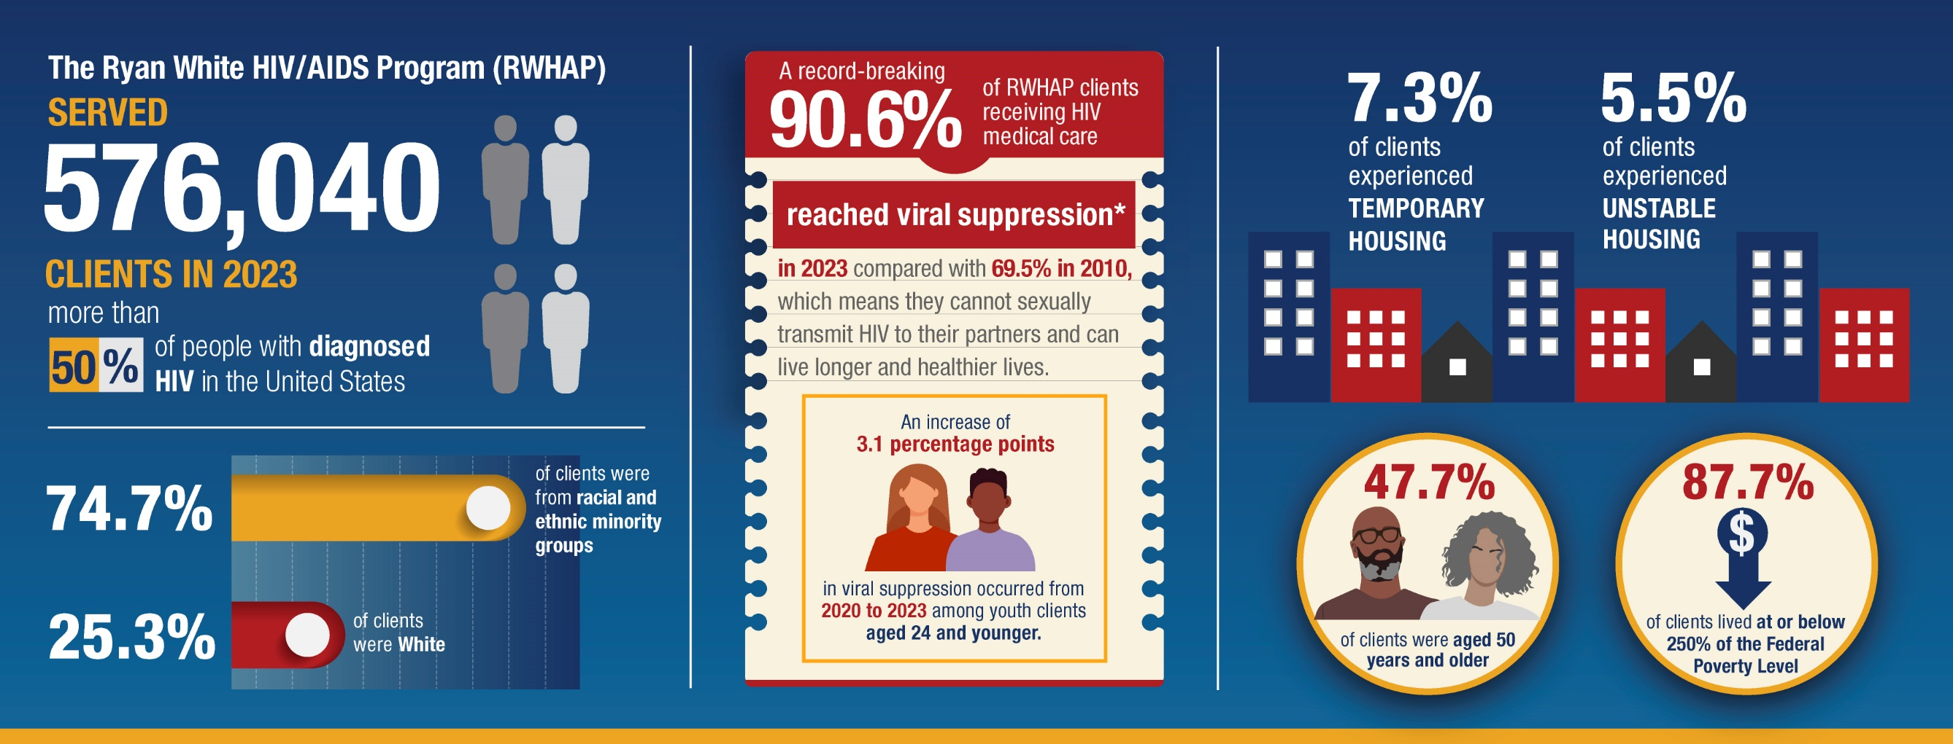
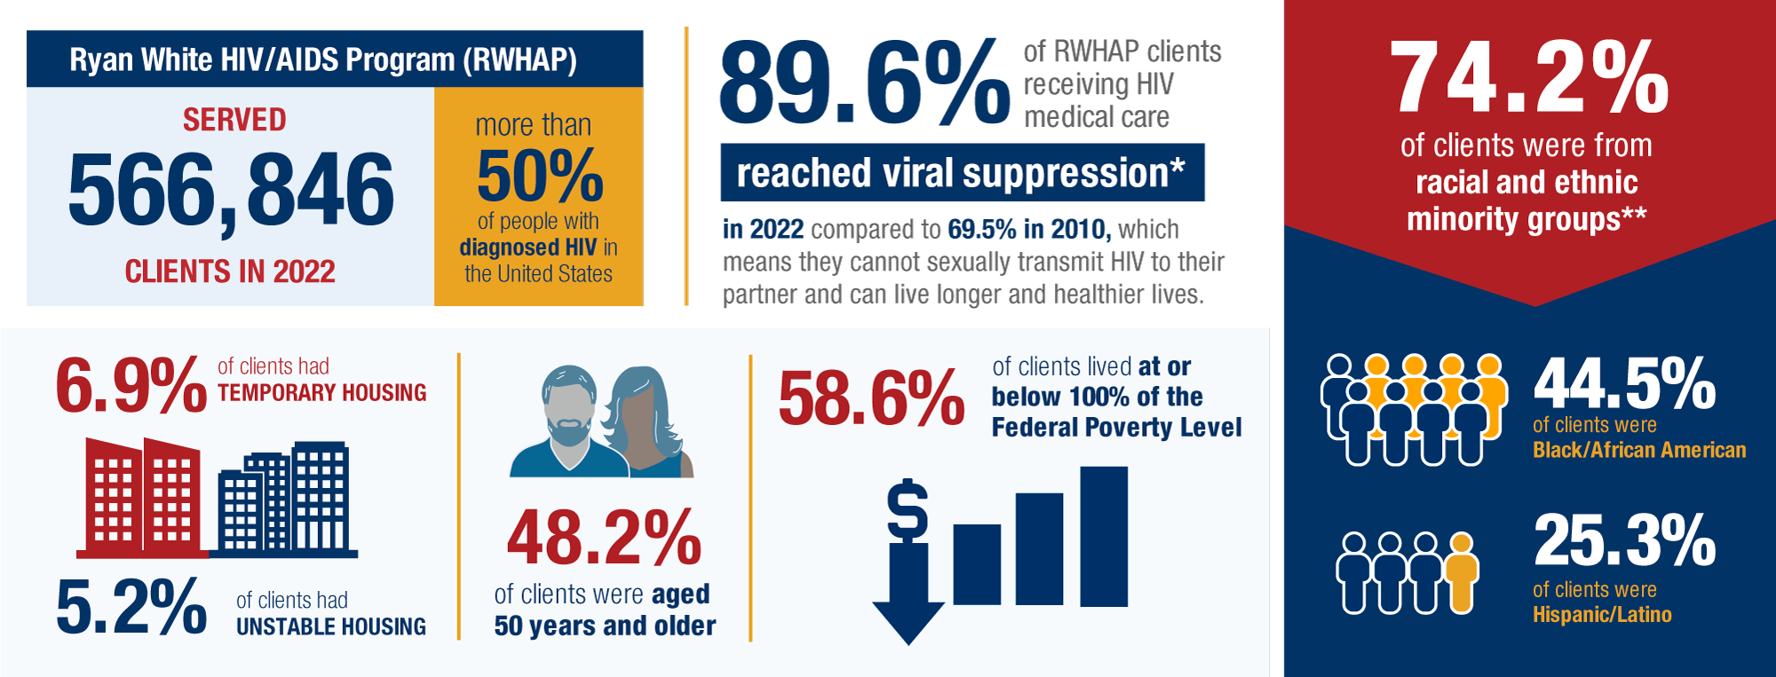
HRSA’s Ryan White HIV/AIDS Program BY THE NUMBERS: 2024
* Viral suppression is based on data for people with HIV who had at least one outpatient ambulatory health services visit and at least one viral load test during the measurement year and whose most recent viral load test result was less than 200 copies/mL.
Source: Health Resources and Services Administration. December 2025. Ryan White HIV/AIDS Program Annual Data Report, 2024. Available at: https://ryanwhite.hrsa.gov/data/reports.
Notes:
Script:
Over this past year, HRSA has been commemorating the 35th anniversary of the historic legislation that created the Ryan White Program. The Ryan White Comprehensive AIDS Resources Emergency (CARE) Act was signed into law on August 18, 1990, creating the Ryan White Program.
The HIV epidemic has significantly evolved over the past 35 years, and our most recent 2024 data highlights the reach and impact of the Ryan White Program. In 2024, the program served an unprecedented nearly 602,000 people– which is over half of all people diagnosed with HIV in the U.S. - helping them live longer lives, manage their HIV as a chronic condition, and preventing forward HIV transmissions.
Additionally, in 2024, a record-breaking 91.4% of patients receiving RWHAP medical care are virally suppressed, up from 69.5% in 2010. That’s something we should all be proud of.

Slide 6

Ryan White Program 2030
REACHING PEOPLE WITH HIV WHO ARE OUT OF CARE
LEVERAGE PARTNERSHIPS
COMMUNITY ENGAGEMENT
FOCUS INTERVENTIONS
Notes:
Script:
The data I just shared and the combination of 35 years of experience as the RWHAP and the past six years of the EHE initiative is why HRSA’s HIV/AIDS Bureau introduced RWP 2030 in early 2024.
Since 2010, we have witnessed viral suppression among people receiving HIV medical care through the Ryan White HIV/AIDS Program climb from 69.5% to 91.4% in 2024.
That incredible progress is thanks to the work you do every day—providing whole-person care to people with HIV in communities across the country. But despite these gains, about 87% of new HIV transmissions are estimated to result from the 34% of people who are either undiagnosed or not engaged in care.
Ryan White Program 2030 (RWP 2030) is a forward-looking framework designed to sustain high-quality care and treatment for current RWHAP clients, while expanding efforts to reach people with HIV who are undiagnosed or out of care. RWP 2030 builds on the foundation of the Ryan White Program, and innovative, low-barrier strategies employed in the EHE initiative. This framework calls for a comprehensive and collaborative approach that: Strengthens and expands partnerships, prioritizes community engagement and implements focused interventions to end the HIV epidemic.
We know that this is not a new concept, but rather a continuation of the work that our Ryan White Program recipients have already been doing for years in your jurisdictions. We want to build on that work and reach the estimated 220,000 people with HIV who are not engaged in care so that we can stop forward transmissions and end the HIV epidemic.

Slide 7

jProg Presenters
Steve Overman, Director
Strategy, scalability, and CAREWare integration leadership
Jeremy Chung, Lead Developer
Technical implementation and FHIR development

Slide 8
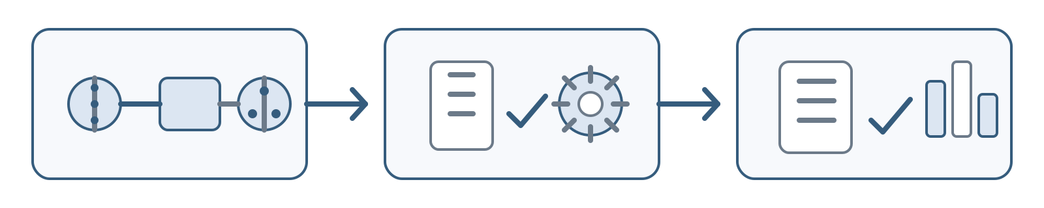
Learning Objectives
After this activity, participants will be able to:
Explain the advantages of using FHIR (Fast Healthcare Interoperability Resources) for RSR (Ryan White Services Report) data integration in CAREWare compared to traditional methods.
Identify the technical and organizational prerequisites for implementing FHIR-based data exchange.
Describe how FHIR integration reduces manual data entry and improves accuracy in RSR reporting.

Slide 9

CAREWare and Fast Healthcare Interoperability Resources (FHIR)
CAREWare is a free electronic health and social support services application started in 2000 through a partnership between the Health Resources and Services Administration (HRSA) HIV/AIDS Bureau (HAB) and the software development company jProg. The system is specifically designed to support recipients and subrecipients of the Ryan White HIV/AIDS Program (RWHAP) managing client-level data to meet legislatively mandated reporting requirements.
What is FHIR?
FHIR is a modern healthcare data standard developed by HL7 that enables different health information systems to exchange data electronically in a consistent, secure, and standardized way using web-based technologies (APIs).

Slide 10
CAREWare and Fast Healthcare Interoperability Resources (FHIR) cont.
Purpose of FHIR
FHIR is designed to:
Improve interoperability between healthcare systems
Enable real-time data exchange using Application Programming Interfaces (APIs)
Simplify integration across platforms (EHRs, public health systems, reporting tools)
Support better care coordination and decision-making
Reduce manual data entry and duplication
CAREWare & FHIR
In recent contracts, the build-out of a FHIR API within CAREWare was added to:
Enable standardized data exchange between CAREWare and external systems (e.g., EHRs)
Support automated reporting and data sharing for Ryan White HIV/AIDS Program requirements
Improve data quality and timeliness
Lay the foundation for scalable, interoperable public health infrastructure

Slide 11
Agenda
Why this work matters
CAREWare and RSR basics
FHIR explained (non‑technical)
Pilot sites and architecture
Results and lessons learned
What’s next

Slide 12
Terms / Acronyms
Ryan White Program Terms
HRSA — Health Resources and Services Administration; the federal agency that oversees the program.
HAB — HIV/AIDS Bureau; the HRSA bureau for HIV care and treatment.
RWHAP — Ryan White HIV/AIDS Program; the federal HIV care and support program.
RSR — Ryan White Services Report; the required annual Ryan White data report.
RWP 2030 — Ryan White Program 2030; HAB’s framework for future program strategy.
EHE — Ending the HIV Epidemic in the U.S. Initiative; the federal initiative to reduce new HIV infections.
OAHS — Outpatient Ambulatory Health Services; routine outpatient medical care services.

Slide 13
Terms / Acronyms
CAREWare + Interoperability
CAREWare — a reporting system for Ryan White client-level data.
FHIR — Fast Healthcare Interoperability Resources; a standard for exchanging health data.
HL7 — Health Level Seven; the healthcare standards organization, and commonly shorthand for its data-exchange standards/protocols used to send health information between systems.
API — Application Programming Interface; a way for systems to exchange data.
EHR — Electronic Health Record; a digital patient health record.
EMR — Electronic Medical Record; a digital medical record within a provider system.
US Core — United States Core Data for Interoperability; standard U.S. FHIR data profiles.

Slide 14
Terms / Acronyms
Clinical / Technical Standards
LOINC — Logical Observation Identifiers Names and Codes; a standard for lab and observation codes.
RxNorm — Normalized names for clinical drugs; a standard for medication names and codes.
ICD-10 — International Classification of Diseases, Tenth Revision; a standard for diagnosis codes.
JSON — JavaScript Object Notation; a common format for structured data exchange.
TLS 1.2 — Transport Layer Security, version 1.2; a security protocol for encrypted connections.
CWFP — cwFhirPath; the CAREWare FHIR pathing file used to locate values in returned FHIR JSON and map them into PDI/CAREWare import fields.

Slide 15

RSR Data Collection Challenges
Manual data entry burden
Data duplication
Accuracy and timing issues
Subrecipient staff and data manager churn/training

Slide 16

CAREWare and the RSR (a Quick Refresher)
CAREWare supports Ryan White HIV/AIDS Program reporting
The RSR is a core federal reporting requirement for Ryan White HIV/AIDS Program grants recipients and their subrecipients
Data accuracy directly impacts oversight and funding

Slide 17
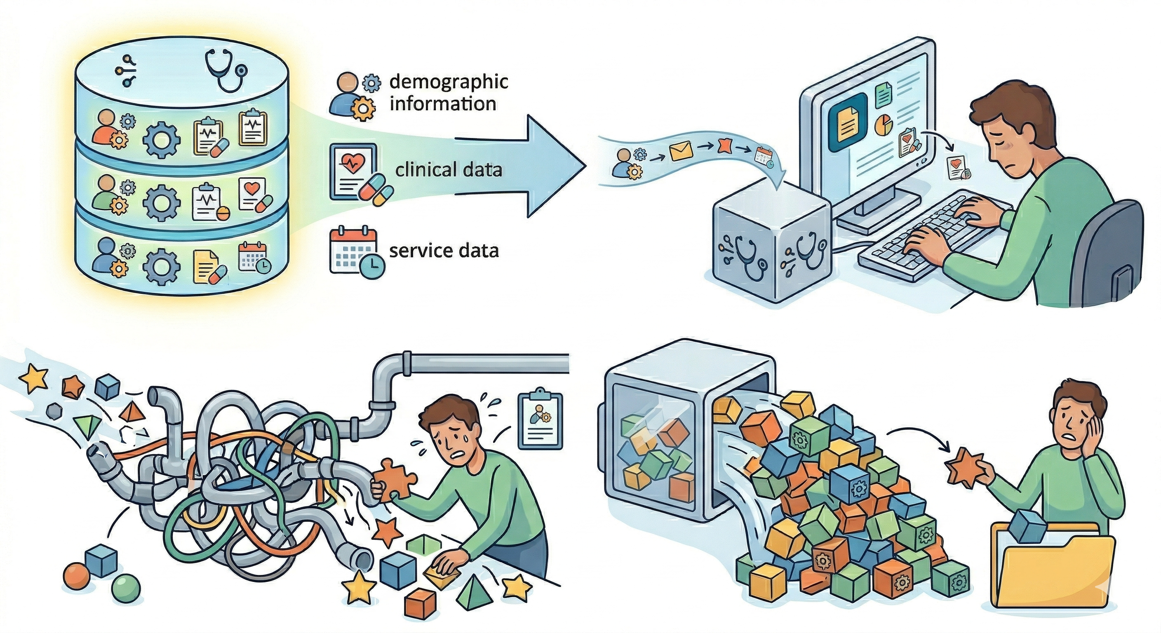
The Interoperability Gap
Most RSR data already exists in EHRs (electronic health records)
Demographic, clinical, some service data
CAREWare often requires manual data entry due to lack of import and interface implementations or specialized reporting requirements
When there is an import or interface, lack of standardized exchange increases burden
Standard HL7 interfaces tend to send more client and clinical data sent than is needed for RWHAP reporting

Slide 18

One solution? FHIR🔥
FHIR (Fast Healthcare Interoperability Resources) is a modern health data exchange standard
Operates secure application programming interfaces
Uses APIs (Application Programming Interface) instead of flat files or extracts
Supported by major EHR vendors

Slide 19

Why FHIR Matters for RWHAP
Reduces repetitive manual work
Improves consistency across systems
Supports long-term scalability

Slide 20

Simple View of How FHIR works with CAREWare
Through the FHIR API, this “conversation” occurs…
CAREWare asks the EMR, “You know Jane Smith?”
EMR says, “Yes! I know her!”
CAREWare asks, “Send me her data over the last X months.”
EMR sends data.
CAREWare consumes mapped RSR elements.

Slide 21

From Abstract to Reality: jProg’s Role
jProg development tasks
Collaboration with HRSA and providers
Focus on scalability and standards compliance

Slide 22


Pilot Overview
Thomas Jefferson University
Epic
Henry J. Austin Health Center
Athena

Slide 23
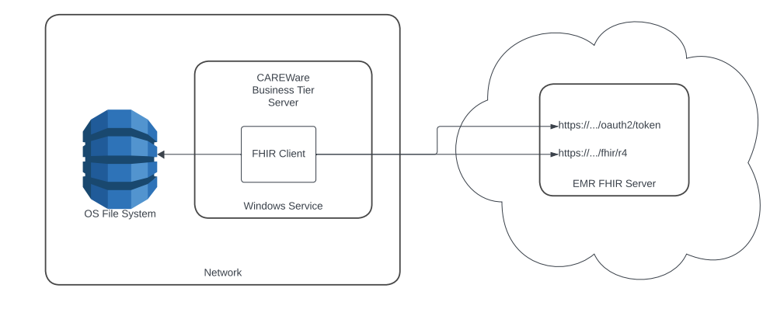
Pilot Architecture
An overview of the FHIR API Architecture:
A request is made to the EMR FHIR server
The EMR FHIR Server processes the request using resource query strings
The EMR FHIR Server returns the JSON and CAREWare converts it into PDI use

Slide 24

FHIR Resources Used
The FHIR resources used:
Patient(R4)
Observations(Labs)
MedicationRequest
Conditions(ProblemList)

Slide 25

Mapping FHIR to RSR Elements
What maps cleanly:
Patient Demographic information maps using US Core.
Conditions (Problem List), known as Diagnosis in CAREWare, map using ICD-10
Customizations/one-off work that was required
LOINC and RxNorm metadata
EMR Ryan White Smart Forms (Insurance, Housing, HIV Status)
Differences between Epic and Athena
Depending on the EMR setup, calling these resources is done differently through the provided query string.

Slide 26

Thomas Jefferson University: Epic Lessons
The Ryan White Smart Form in EPIC EMRs
Majority of the fields in this form can be mapped into CAREWare using the metadata of the field. For example, HIV Status might be mapped to EPIC#31000005214.
Filling RSR gaps
Getting patients RSR ready was a matter of mapping all the required elements to the form field provided in the Ryan White Form.
What took the most effort
Initial metadata mapping for LOINC and RxNorm.
Custom CWFP files made for Ryan White Smart Forms.

Slide 27

Henry J. Austin Health Center: Athena Lessons
Strong native alignment
Default mappings to US-core values allowed for easier mapping of clients.
Less customization required
A short list of RxNorm and LOINC codes needed to be added.
Faster time to usable data
Immediate results from the FHIR query allowed for instant reporting of new labs and diagnosis.

Slide 28

Security & Compliance Considerations
CAREWare’s FHIR implementation is an API
This requires servers to be on TLS 1.2 to send out valid HTTP Requests
EMRs can individually set restrictions in place for usage of the FHIR API/Resources
Restrictions such as how CAREWare is allowed to query a resource can limit data pulls
File system requirements
CAREWare’s FHIR API requires the use of CWFP files, which are stored on the BT Server.

Slide 29

Benefits Observed
Reduced manual entry
Improved data completeness
Faster reporting readiness
Daily automated updates of clients
Others?

Slide 30

What Didn’t Go Smoothly
Data normalization challenges
Resource variability between EHRs
Pilot staff availability and participation

Slide 31
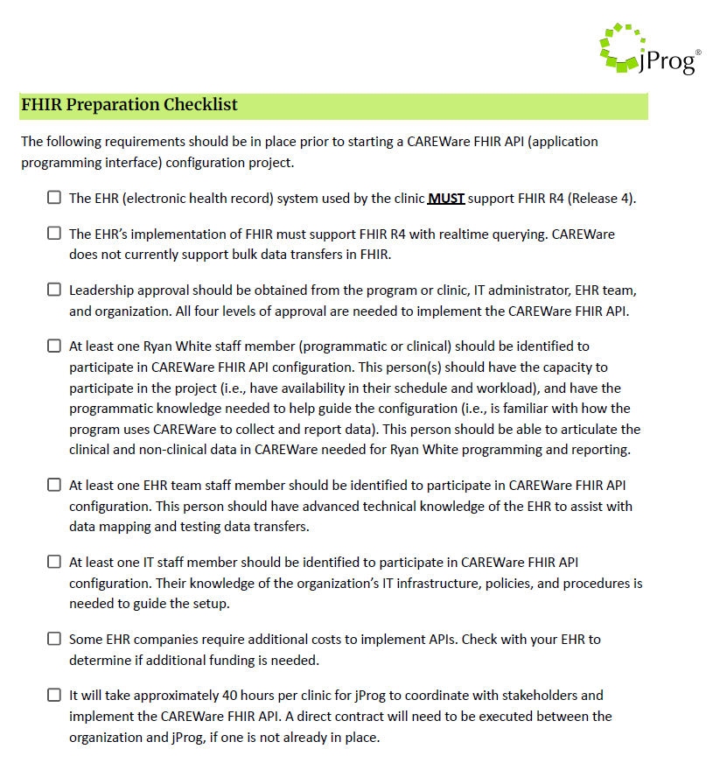

Organizational Readiness Checklist
EHR vendor capability
Cost (if applicable)
Leadership buy‑in
Data governance readiness
Technical staffing

Slide 32

Scaling This Work
Additional providers
Contact jProg for more information
Broader RSR element coverage

Slide 33
What This Means for Attendees
What you can do now
All Aboard!
EMR support/charges?
What can you get from your EMR?
Who this helps most
OAHS providers
Others?
When this may be relevant
You have an EMR

Slide 34

Key Takeaways
FHIR is viable now
One size does not fit all
Standards reduce long‑term pain

Slide 35
Resources & References
CAREWare
Implementing the CAREWare FHIR API at your Organization
FHIR Preparation Checklist
CAREWare FHIR User Guide
HL7 FHIR
HRSA RSR resources

Slide 36
Contact Information
Kwasi Apraku-Gyau
Sr. Management Analyst
HIV/AIDS Bureau (HAB)
Health Resources and Services Administration (HRSA)
Email: kaprakugyau@hrsa.gov
Web: ryanwhite.hrsa.gov
Daniel Compton
Sr. Informaticist
HIV/AIDS Bureau (HAB)
Health Resources and Services Administration (HRSA)
Email: dcompton@hrsa.gov
Web: ryanwhite.hrsa.gov

Slide 37
Contact Information
Steve Overman
jProg
https://www.jprog.com/
steveoverman@jprog.com
Jeremy Chung
jProg
https://www.jprog.com/
jeremychung@jprog.com

Slide 38

Connect with the Ryan White HIV/AIDS Program
Learn more about our program at our new website:
ryanwhite.hrsa.gov
Sign up for the Ryan White HIV/AIDS Program Listserv:
https://public.govdelivery.com/accounts/USHHSHRSA/signup/29907

Slide 39





Connect with HRSA
Learn more about our agency at:
www.HRSA.gov
FOLLOW US:

